Slide 1
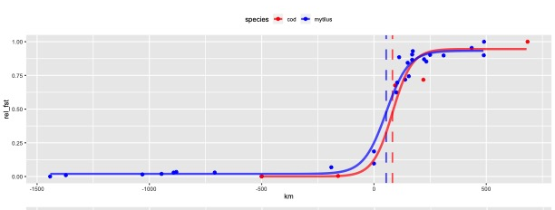
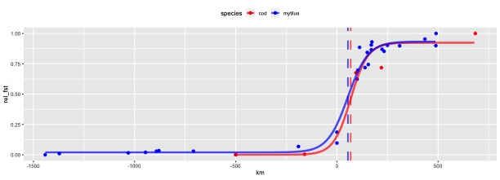
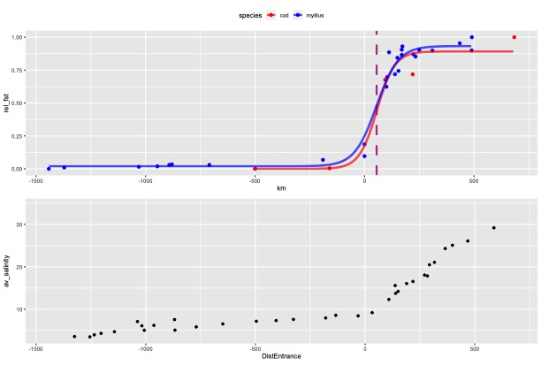
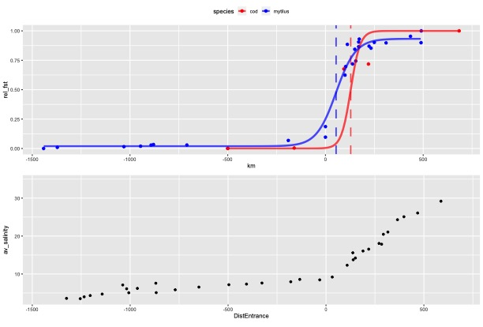
There are four versions of the cline fit depending on the initial parameters:
1: different centres and same width
2: same centre values different width
3: same centre and same width
4: different centres different widths

Slide 2
